Slide 1
Software Quality Assurance and Testing
Lecture -03
Harish Aggarwal

Slide 2
CMMI, ITIL

Slide 3
Re-Cap
Lecture - 01
Definitions – S/W Quality, S/W Quality Assurance
Importance of QA
Causes of Defects
Business Models in S/W
S/W Cost, Quality Cost
Quality culture
Lecture - 02
Software Quality Models
McCall, IEEE 1061, ISO 25000 Series
Quality Requirements
Quality of Requirements
Frameworks
ISO/IEC/IEEE 12207 - Software Life Cycle Processes

Slide 4
Agenda
Frameworks
CMMI-Development
ITIL Framework
Other Frameworks
ISO/IEC 20000 Standard
CobiT Process - Best practices for IT governance.
ISO/IEC 27000 Family of Standards for Information Security
ISO/IEC 29110 Standards and Guides for Very Small Entities

Slide 5
CMM
Capability Maturity Model (CMM®).
Developed at the request of the American DoD, by the Software Engineering Institute (SEI) at Carnegie Mellon University.
Primarily focused on software engineering practices
Provides a road map of engineering practices to improve the performance of the development, maintenance and service provisioning processes.
Capability Maturity Model Integration (CMMI):
CMMI is an evolved version of CMM and is a framework that encompasses not only software engineering but also various other domains, including systems engineering, project management, and service delivery.

Slide 6
CMMI – Key Aspects
Key aspects of CMMI include:
Continuous and Staged Representations: CMMI supports two representations –
Continuous - Allows to select and implement individual process areas based on their specific needs.
Staged - Requires organizations to follow a predefined sequence of maturity levels.
Process Areas: Defines specific process areas at each maturity level
Examples include Requirements Management, Project Planning, and Configuration Management.
Appraisals: CMMI certification such as SCAMPI (Standard CMMI Appraisal Method for Process Improvement).
Process maturity and
Adherence to CMMI practices.
Evolution: CMMI has evolved beyond its initial focus on software engineering to cover various disciplines.
CMMI for Development,
CMMI for Services, and
CMMI for Acquisition

Slide 7
CMMI – Appraisal
CMMI Institute authorizes and oversees organizations to provide official CMMI training and appraisal services.
CMMI Institute is a subsidiary of ISACA - International professional association focused on IT (information technology) governance or (Information Systems Audit and Control Association)
Appraisal Sponsor Organizations (ASOs): Organizations authorized by the CMMI Institute. They have certified lead appraisers and are responsible for ensuring the quality and integrity of the appraisal process.
CMMI Institute Partner Organizations: These organizations collaborate with the CMMI Institute to deliver official CMMI training and appraisal services.
Certified Lead Appraisers (CLAs): Individuals who have undergone CMMI Institute-approved training and certification processes to become certified lead appraisers.

Slide 8
CMMI
The five maturity levels of CMM were:
Level 1 - Initial:
Processes are ad-hoc and chaotic.
Processes are unpredictable, poorly controlled, and reactive.
There is no standardization, and success depends on individual heroics and efforts.
Organizations at this level often experience high variation in process performance
Frequent crisis management.
Level 2 - Repeatable: Basic project management processes are established.
Processes are defined at the project level, and there is consistency in project execution.
Processes are documented and communicated.
Project performance is monitored, and corrective actions are taken.

Slide 9
CMMI
Level 3 - Defined: Processes are well-defined, documented, and standardized across the organization
Standardized and documented processes at the organizational level.
Emphasis on proactive management.
Process metrics are collected and used for process improvement.
Implement a culture of continuous improvement.
Level 4 - Managed: Detailed measurements of processes and their effectiveness are collected.
Quantitative objectives are set for process performance.
Process performance is measured and controlled quantitatively.
Variability in process performance is reduced.
Identify and address the root causes of process variation.
Level 5 - Optimizing: Continuous process improvement is institutionalized.
Focus on innovation, optimization, and process improvement at both the organizational and project levels.
Continuous improvement is part of the organizational culture.
Process improvements are based on quantitative feedback.
Best practices are identified and shared across the organization.

Slide 10
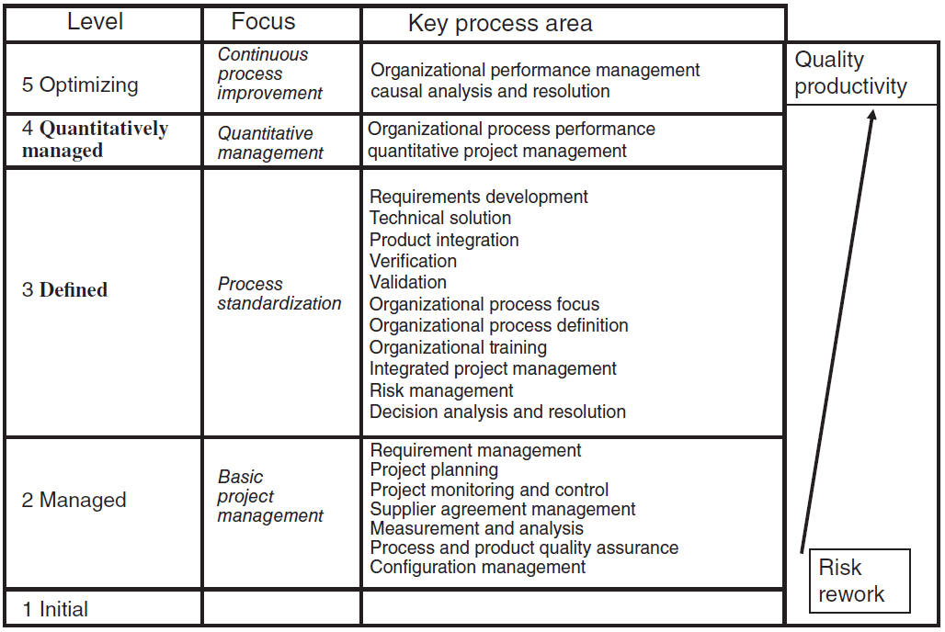
CMMI for Development

Slide 11
CMMI-Dev Model L-1
Maturity Level 1: Initial
Processes are usually ad hoc and chaotic.
Success in these organizations depends on the competence and heroics of the people
Abandon their processes in a time of crisis, and be unable to repeat their successes.

Slide 12
CMMI-Dev Model L-2
Maturity Level 2: Managed
Processes are planned and executed in accordance with policy
Able to produce controlled outputs. Practices are retained during times of stress.
Process areas:
Requirements management - manage requirements of the project’s products and product components.
Project planning - Establish and maintain plans that define project activities
Project monitoring and control - Provide an understanding of the project’s progress
Supplier agreement management - Manage the acquisition of products and services from suppliers
Measurement and analysis - Develop and sustain a measurement capability used to support management information needs.
Process and product quality assurance - Provide staff and management with objective insight into processes and associated work products. Identify non-compliance.
Configuration management – Maintaining Baselines and controlling changes.

Slide 13
CMMI-Dev Model L-3
Maturity Level 3: Defined
Processes are well characterized and understood, and are described in standards, procedures, tools, and methods.
Processes are improved over time.
Processes are used to establish consistency across the organization.
Process areas include :
Requirements development - Elicit, analyze, and establish customer, product, and product component requirements
Technical solution - Select, design, and implement solutions to requirements
Product integration - Assemble the product from the product components
Verification - Ensure that selected work products meet their specified requirements
Validation - Demonstrate that a product or product component fulfills its intended use.
Organizational process focus - Plan, implement, and deploy organizational process improvements.
Organizational process definition - Establish and maintain organizational process, standards, rules and guidelines for teams.
Organizational training - Develop skills and knowledge of people.
Integrated project management – Manage Project, Include stakeholders.
Risk management - Identify potential problems before they occur.
Decision analysis and resolution - Analyze possible decisions using a formal evaluation process.

Slide 14
CMMI-Dev Model L- 4 & 5
Maturity Level 4: Quantitatively managed
The organization and projects establish quantitative objectives for quality and process performance and use them as criteria in managing projects.
Quality and process performance is understood in statistical terms and is managed throughout the life of projects.
Process areas include:
Organizational process performance - Establish and maintain a quantitative understanding of the performance of selected processes.
Quantitative project management - Quantitatively manage the project to achieve the project’s established quality and process performance objectives.
Maturity Level 5: Optimizing
An organization continually improves its processes based on a quantitative understanding of its business objectives and performance needs. Process areas -
Organizational performance management - Proactively manage the organization’s performance to meet its business objectives.
Causal analysis and resolution - Identify causes of selected outcomes and take action to improve process performance

Slide 15
ITIL Framework
ITIL stands for Information Technology Infrastructure Library
A set of best practices for IT service management (ITSM)
Created in Great Britain based on good management practices for computer services
For IT services - Backup copies, Recovery, Computer Administration, Telecommunications, Production data, etc
Service operation processes focus more on longer term management than support processes
The main objective is to ensure that the IT infrastructure meets the business requirements of the organization.

Slide 16
ITIL – Key components
Key Components (Phases)
Service Strategy
Focuses on understanding and aligning IT services with the business strategy.
Defines the overall vision, mission, and goals for IT services.
Service Design
Design of new or changed services, including processes, architectures, and documentation.
Ensures that IT services are designed to meet business requirements and expectations.
Service Transition
Focuses on transitioning new or changed services into the live environment.
Involves change management, release and deployment management, and knowledge management.
Service Operation
Concerned with the day-to-day operation of IT services.
Includes incident management, problem management, event management, request fulfillment, access management.
Continual Service Improvement (CSI)
A core principle throughout the ITIL lifecycle.
Involves measuring, monitoring, and improving IT services and processes over time.

Slide 17
ITIL Processes
ITIL describes the Service Support center function and the following five processes:
Incident management - Ensures all IT issues (“incidents”) are logged, and tracked to resolution without being lost, ignored, or forgotten about.
Problem management - To reduce the likelihood and impact of incidents by identifying actual and potential causes of incidents and managing workarounds and known errors.
Configuration management - Manage and control assets that make up an IT service.
Change management - To ensure that changes are recorded, evaluated, authorized, prioritized, planned, tested, implemented, documented, and reviewed in a controlled manner
Commissioning/Release management - Plan, schedule, and control releases from end to end

Slide 18
ITIL Processes
ITIL describes the following five processes for Service Operation:
Service level management - Maintaining Service Catalogue. Agreement and maintaining of Service Level Agreements
Financial management of IT services - Accounting, budgeting, and charging services so that the organization covers costs and generates profits for those services
Capacity management – Planning capacity (Software, Hardware, Human Resources) to provide optimum and cost effective provision of IT Services based on current and future demand.
IT service continuity management - Defines and plans all measures and processes for unpredicted events of disaster based on regular analysis of vulnerabilities, threats and risks.
Availability management - Sustained availability of the IT infrastructure as per agreed SLA.

Slide 19
ITIL History and evolution
History and evolution
ITIL – 1980’s
ITIL V2 – 2000/2001
ITIL v3 – 2007
ITIL V4 – 2019
The ISO/IEC 20000 standard is the first ISO standard dedicated to managing IT services and is based on ITIL Framework

Slide 20
ITIL Certifications
ITIL Foundation:
Entry-level certification providing an understanding of ITIL concepts and terminology.
ITIL Practitioner:
Focuses on applying ITIL principles in a practical context.
ITIL Intermediate:
Offers two paths (Service Lifecycle and Service Capability) with multiple modules covering specific areas of ITIL.
ITIL Expert:
Achieved by accumulating credits from both Foundation and Intermediate levels.
ITIL Master:
The highest level of ITIL certification, demonstrating the ability to apply ITIL principles in real-world situations.

Slide 21
Other Standards
ISO/IEC 20000 Standard
The ISO/IEC 20000 standard is the first ISO standard dedicated to managing IT services and is based on ITIL Framework
CobiT Process (Control Objectives for Information and Related Technology)
Repository of best practices for IT governance established by ISACA (IT auditors)
Harmonized with the ITIL reference, the PMBOK® Guide from the Project Management Institute [PMI 13] as well as the ISO 27001 and ISO 27002 standards
ISO/IEC 27000 Family of Standards for Information Security
Preservation of confidentiality, integrity and availability of information
ISO/IEC 29110 Standards and Guides for Very Small Entities
For VSEs, namely enterprises, organizations, departments or projects with up to 25 people.

Slide 22
SQA – Standards and Resources
ISO/IEC/IEEE 12207:2017
ISO/IEC –
International Organization for Standards/International Electrotechnical Commission
Software life cycle processes standards
https://www.iso.org/standard/63712.html
Earlier ISO/IEC 12207:2008
IEEE 730-2014 (Institute of Electrical and Electronics Engineers (IEEE))
IEEE Standard for Software Quality Assurance Processes
https://standards.ieee.org/ieee/730/5284/

Slide 23
SQA – Standards and Resources
CMMI Development (Capability Maturity Model Integration)
https://cmmiinstitute.com/cmmi/dev
ISO Guide to the Software Engineering Body of Knowledge (SWEBOK)
https://www.computer.org/education/bodies-of-knowledge/software-engineering

